Slide 1

RECEPTION
New Starters
2023-24

Slide 2
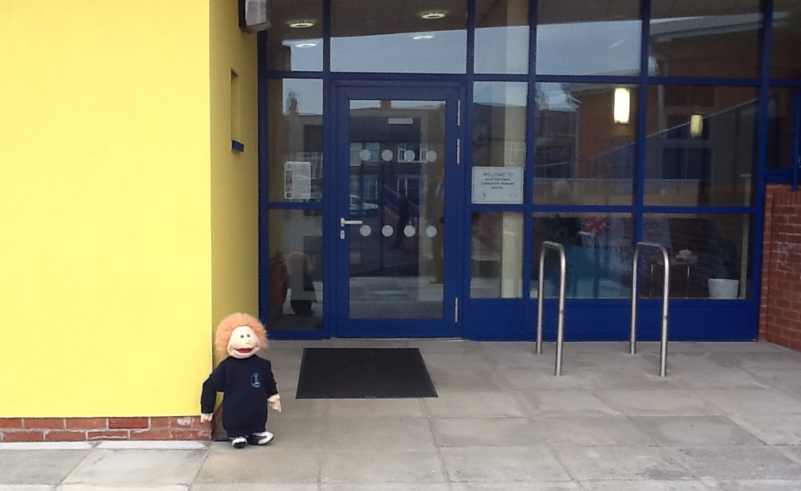
Welcome to Huntingtower Academy

Slide 3
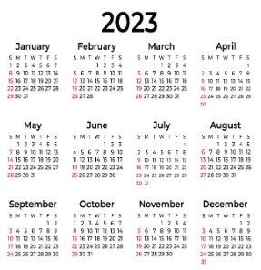
Important Dates
Over the next few slides, there will be information to highlight key dates.
We will also be requesting necessary paperwork to ensure everything is in place ready for children starting in September.

Slide 4
Academy Taster Session
We are excited to announce that your child is invited to attend a half-day taster session on
Tuesday 4th July 2023.
This will be a morning or an afternoon visit.
Morning: 9.15- 11.30am Afternoon: 12.30-2.45pm
You will receive an email to inform you of which session your child will be attending.
Drop off and pick up will be via the main office.

Slide 5


Classes
On the taster visit, you and your child will find out which class they will be in.
Our Early Years/Reception unit is made of two classes- Kangaroos and Koalas.
The two classes remain separate during carpet time and combine during Continuous Provision and play times.

Slide 6

Home Visits
Optional home visits will be available on
Monday 17th July or Tuesday 18th July.
This will provide another opportunity for us to meet your child and for you to ask any questions you may have.
Please sign up tonight if you would like an appointment.

Slide 7
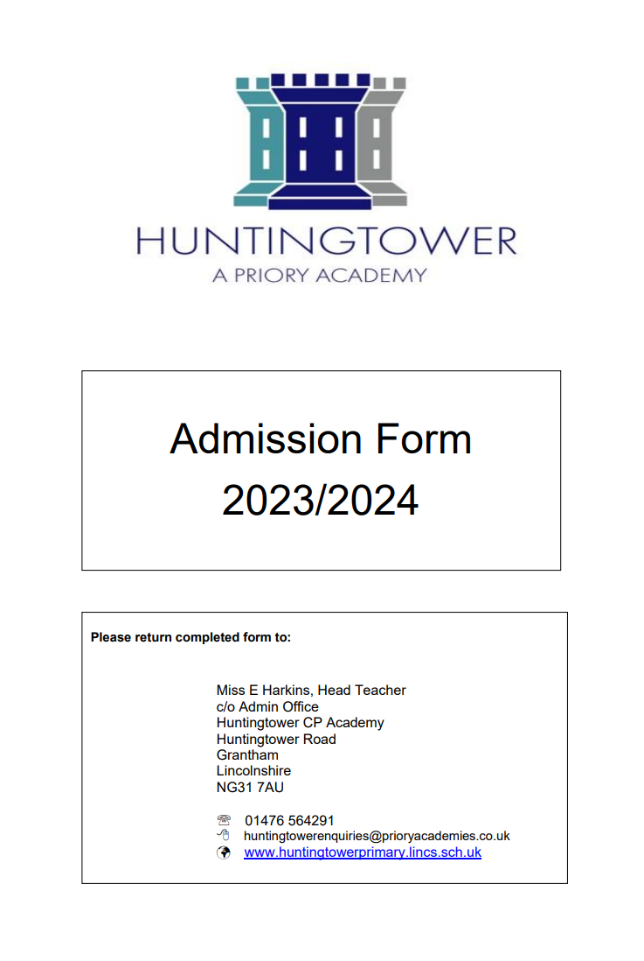
Admissions Form
You have an admissions form in your pack. Please complete and return by no later than Tuesday 4th July (taster session date).
This document is crucial as it will provide us with important details such as emergency contacts and medical information.

Slide 8
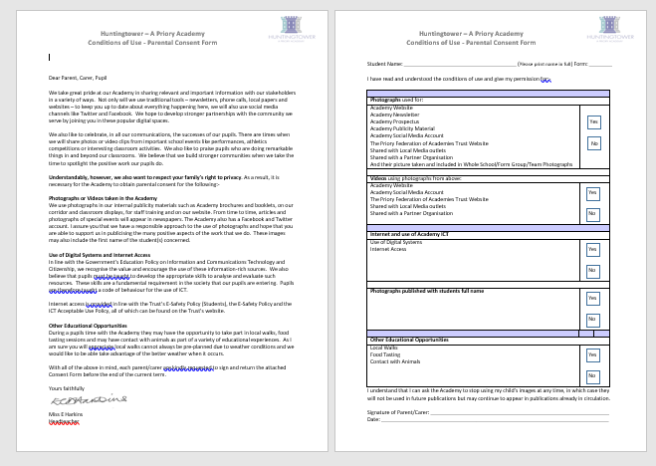
Permissions Consent Form
You also have a permissions consent form (for photographs, videos, food tasting, local walks etc)
Again, please complete and return by no later than Tuesday 4th July 2022 .

Slide 9
The Priory Contract
All Priory Academies have a home-school contract.
It is a list of the core values for pupils, staff, parents/carers and governors.
Please read carefully, sign and return by Tuesday 4th July.

Slide 10
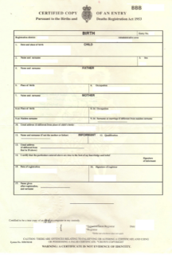
Birth Certificate
It is a legal requirement to see your child’s birth certificate before they start.
You can present this tonight- please see one of our admin team.
If you have not brought your child’s birth certificate this evening, please present it to the main office as soon as possible please.

Slide 11

Communication
We aim to fully involve parents within their child’s learning- parents as partners.
We use Parent Hub to email any important letters/information- please check regularly.
ClassDojo is an online class page which enables you to see what your child’s class have recently been learning. Information can be translated.

Slide 12

Communication
Tapestry is an electronic learning journal used by the Early Years staff as a means of recording your child’s learning observations i.e notes, photographs. This will be unique to your child.
Parents do not have access to the Tapestry journal but do get a copy of it at the end of the academic year.
Class Dojo and Tapestry do require you to sign a permission form in order for us to create an account for your child.

Slide 13
Transition Visits/Staggered Intake
To enable a smooth transition into school, we provide a short staggered intake.
During their first week, children will complete one half-day session before starting full time with us.
These sessions will start the week beginning
Monday 4th September- session dates and times will vary.
Children will be in smaller groups during these visits.

Slide 14
Transition Visits/Staggered Intake
The dates for September will be provided at the taster session on Tuesday 4th July.
You are required to sign a permission form to agree to the staggered intake- electronically.

Slide 15
Nurseries/Early Years Settings
We are already communicating with nurseries and childcare providers.
Mrs Giles and Mrs Cradduck are in the process of meeting children in their current settings.
Settings will send reports and/or online learning journals to school for Reception teachers to read.

Slide 16
Uniform
Our uniform is available to purchase online from Uniform Direct –please see leaflet in pack.
It is best to order uniform in July to allow plenty of time.
It does not need to be purchased from this website, however, it does need to meet our uniform expectations.
P.E t-shirts will be available to order after children start in September as they will be allocated a tower team colour at this point.

Slide 17
Uniform
Uniform Policy
Boys
Pale blue polo shirts (not cotton shirts)
Either school logo sweatshirt or plain navy ‘V’ neck jumper
(no hooded wear at all)
Trousers – grey school trousers (school tailored shorts in the summer)
Black school shoes (no boots or trainers)
Navy blue fleece with or without the school logo
Plain grey socks
Girls
Pale blue polo shirts (not cotton shirts)
Either school logo sweatshirt or plain navy ‘V’ neck jumper or girls cardigan (no hooded wear at all)
Girls: Grey school trousers or grey skirt or pinafore (checked or striped blue dress in the summer)
Black school shoes (no boots or trainers)
Navy blue fleece with or without the school logo
Plain white or grey socks - tights (grey)

Slide 18
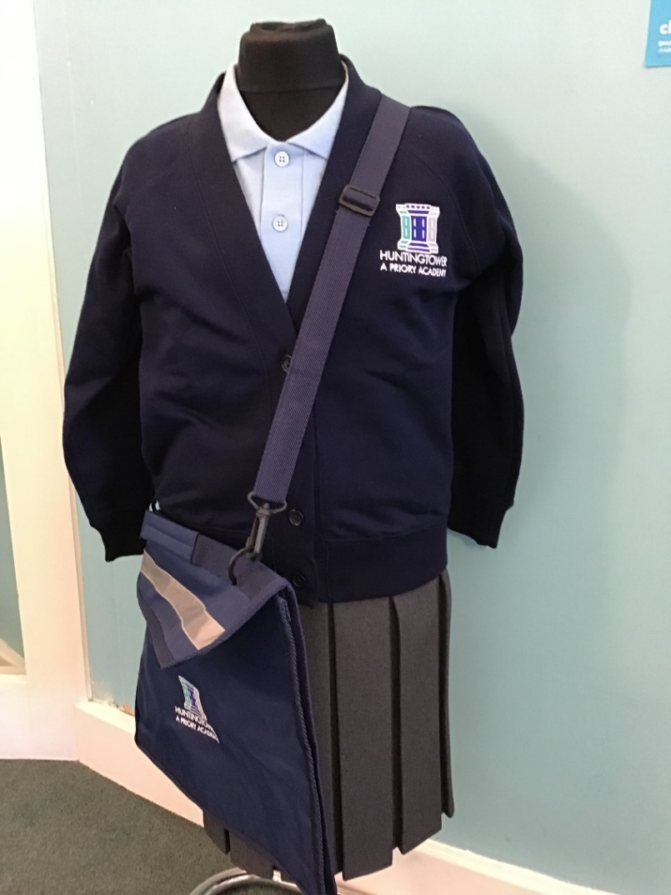
Uniform
ALL UNIFORM NEEDS TO BE NAMED PLEASE

Slide 19
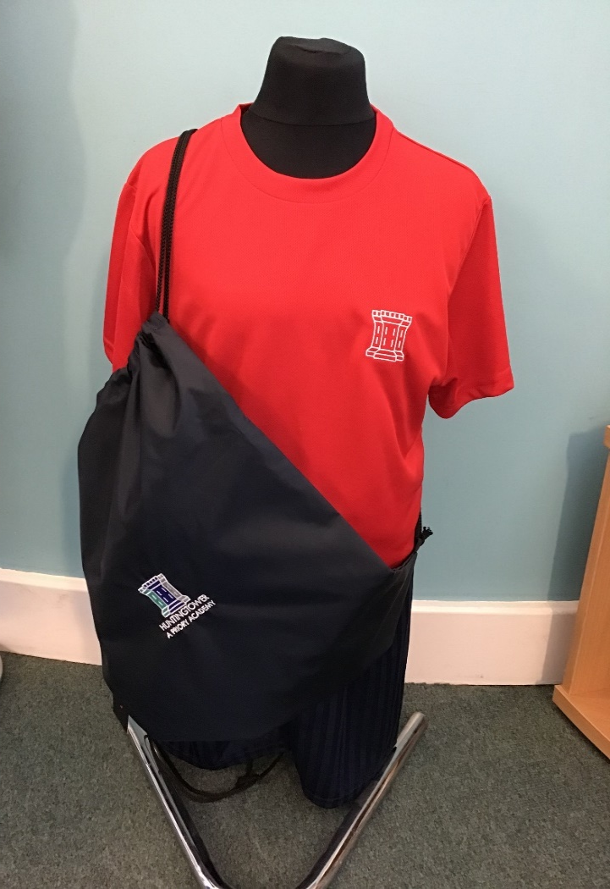
P.E Kit
School PE Top – Tower Team colour
Navy Blue shorts/jogging bottoms/leggings
Black Plimsolls/trainers
School jumpers or cardigans are worn over
the top.
Children now come to school in their
kit on P.E days and wear it all day.
ALL UNIFORM NEEDS TO BE NAMED PLEASE

Slide 20
Things to Bring to School
To be kept in school:
Spare clothes (trousers, t-shirt, jumper, underwear and socks)
To bring each day:
Suitable warm/waterproof coat
Book bags: reading records and reading books (book bag available to order on Uniform Direct website)
Water bottle- only water please (first one is provided free of charge)
Sun hats in the warmer weather
Hat/scarf/gloves in cold weather
ALL ITEMS NEED TO BE NAMED PLEASE

Slide 21
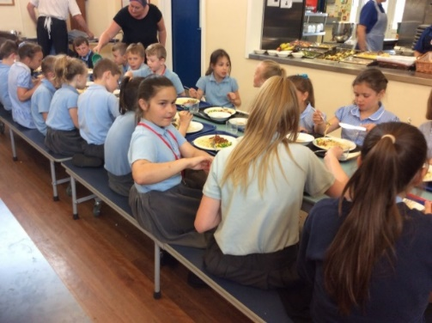
Lunch/Snacks
Free lunches for Reception, Year 1 and Year 2. These are known as Universal Free School Meals.
Free lunches are compulsory for Reception pupils. We can meet a wide range of dietary needs- hot and cold food.
Fruit and milk are also provided.
Meals can be pre-ordered on your Parent Pay account- 1 of 4 options.

Slide 22
Free School Meal application
You are able to apply for Free School Meals, which is done through Lincolnshire County Council.
The application information in your pack. We encourage to apply as you will then automatically receive any Government initiatives such as Holiday Activity Fund Clubs and Holiday Support Fund (food vouchers). These are only available to those who are entitled to Free School Meals, NOT just Universal Free School Meals

Slide 23
Before and After School Provision
For parents who require wraparound childcare (before and after school provision) we have provision on site- Club House
The provision is ran by an external provider- Headstart- please see them for details e.g cost.
Club House opens at 8am and closes at 6pm and is located in our Extended Provision building.

Slide 24
What shall I do now?
Complete and hand back admissions form and consent forms.
Please let us know of any important medical information/allergies.
Present your child’s birth certificate.
Make an appointment for a home visit.
Take a look at our uniform on the Uniform Direct website (best to order in July)
Keep checking emails for any further information e.g class, tower team.
Speak to Club House if you require before and after school childcare.

Slide 25


A typical day in the EYFS
Registration
Read Write Inc Phonics + Continuous Provision
Phonics Workshop for parents- October

Slide 26
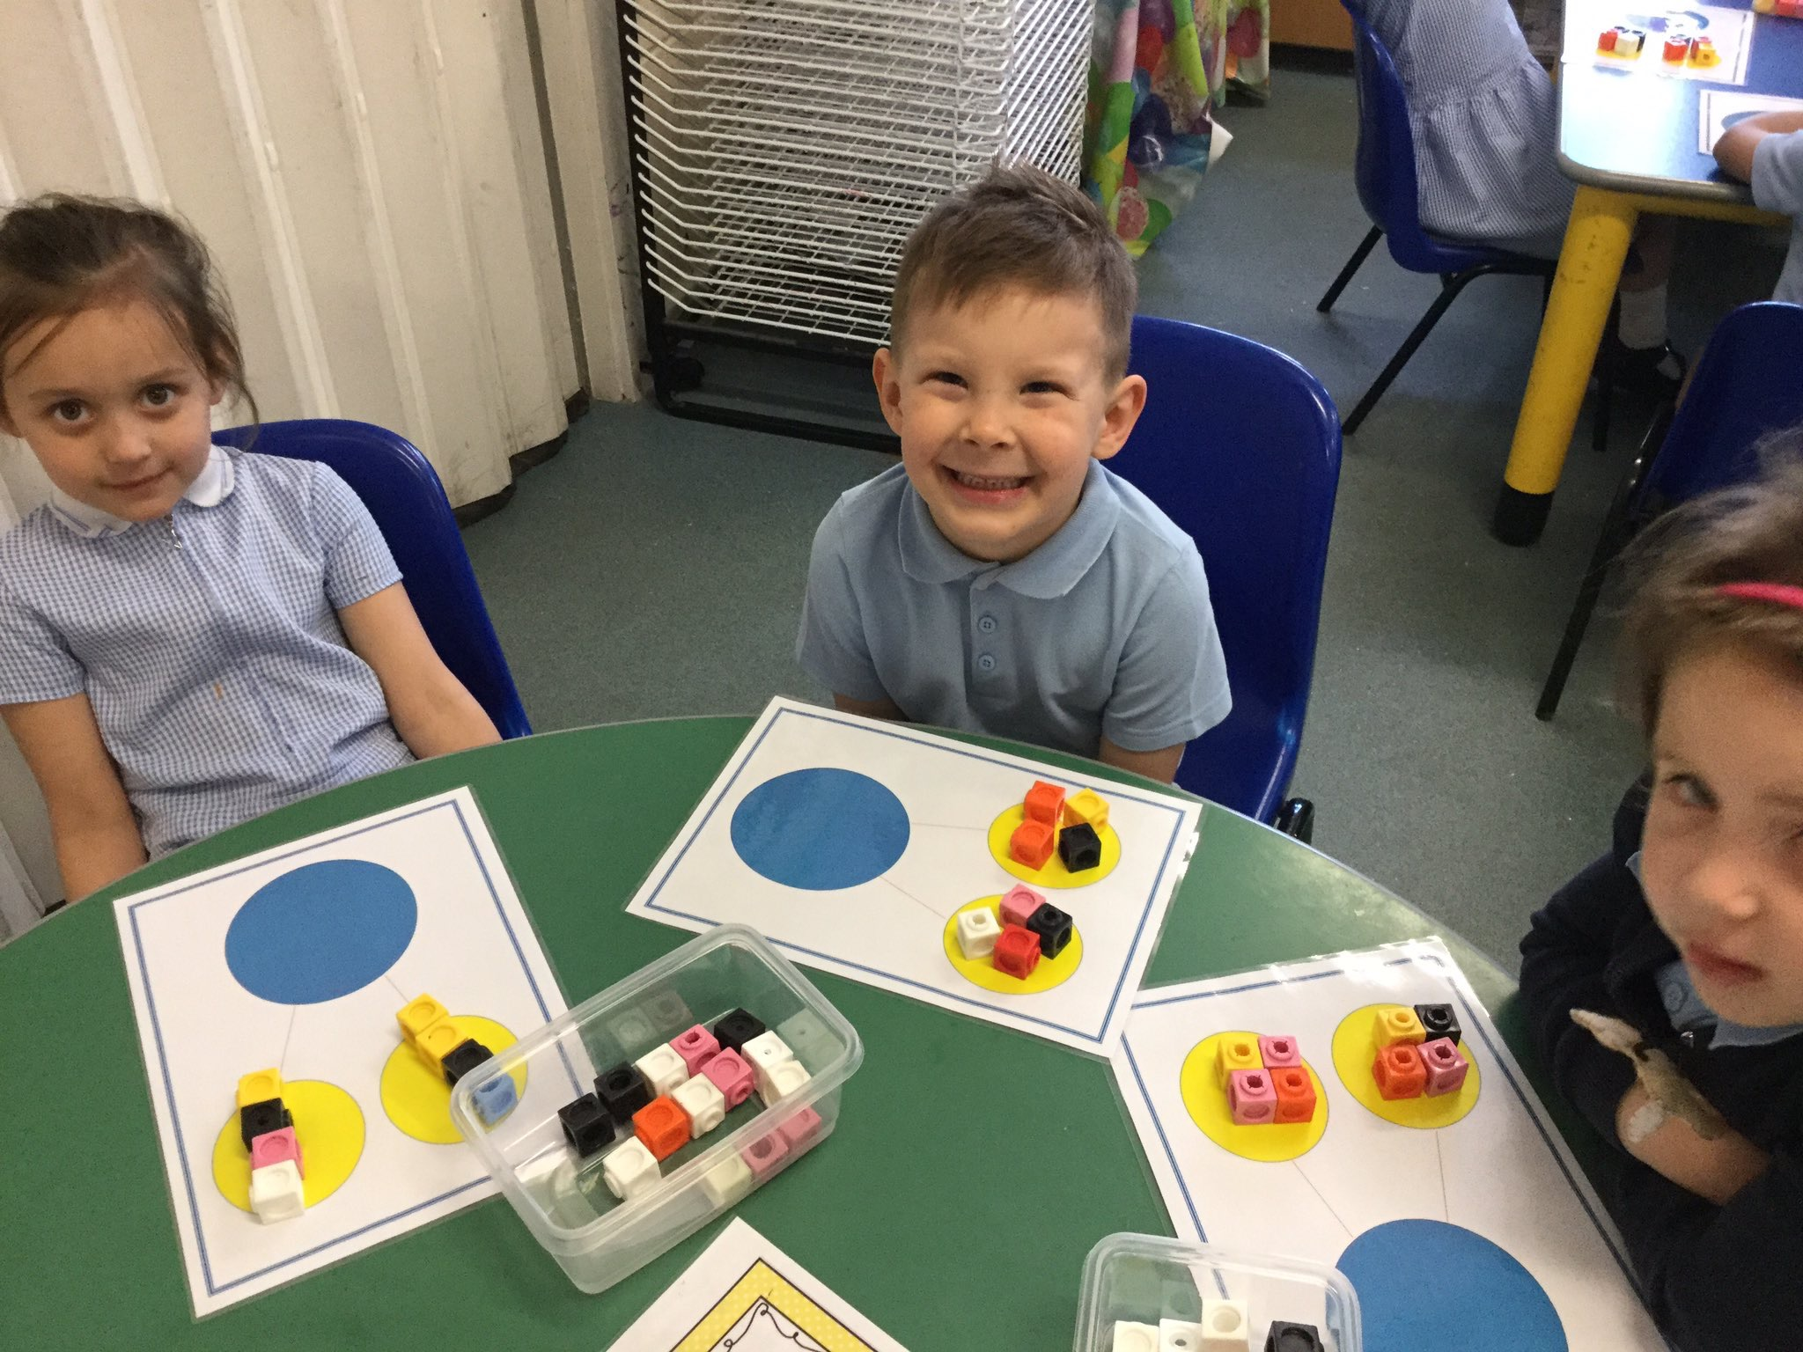
A typical day in the EYFS
Snack Free fruit and milk provided by school.
Mathematics + Continuous Provision

Slide 27
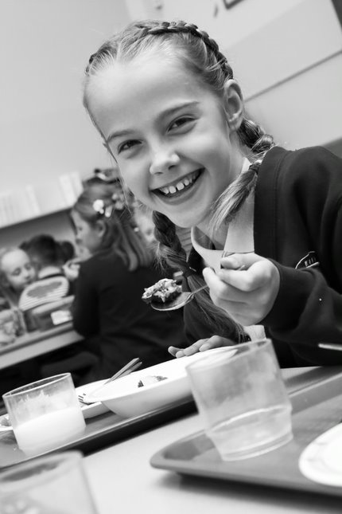
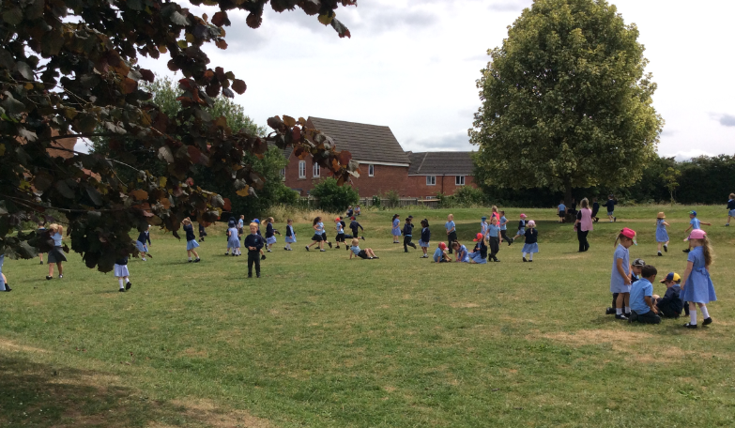
A typical day in the EYFS
Lunch time- free hot lunches for Reception, Year 1 and Year 2.
Free lunches are compulsory for Reception pupils. We can meet a wide range of dietary needs.

Slide 28
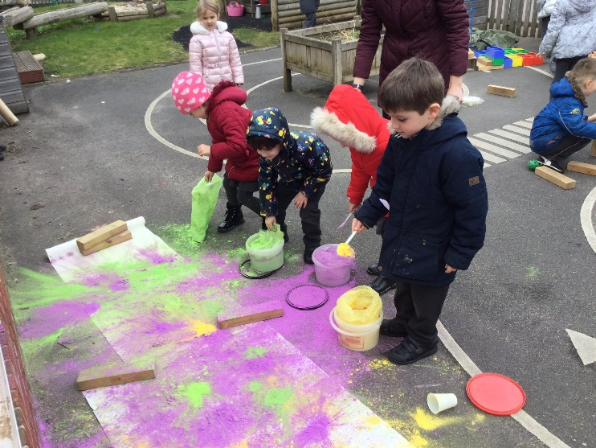
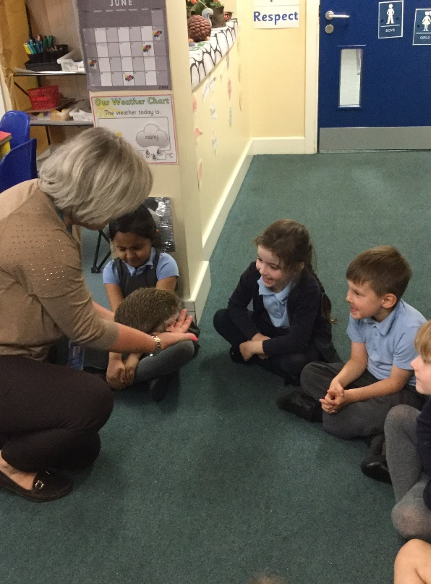
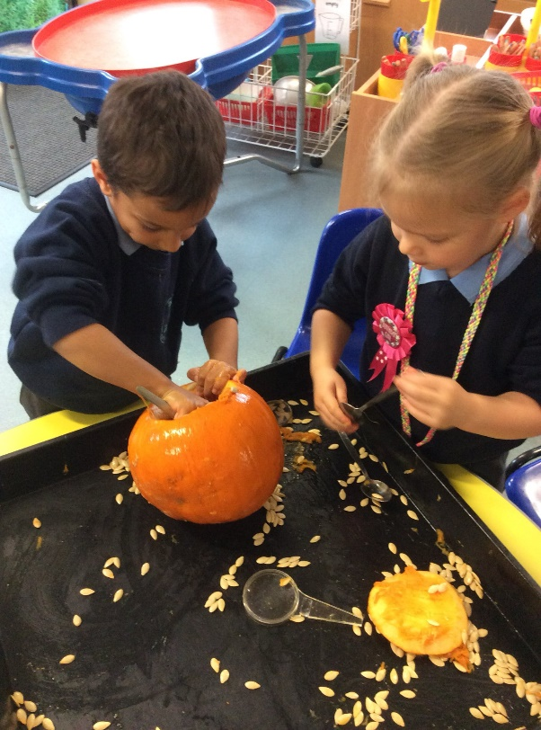
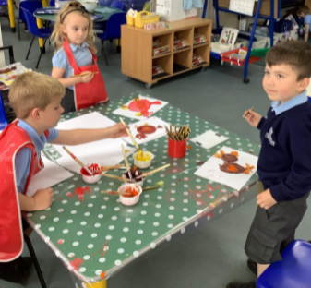
A typical day in the EYFS
The Wider Curriculum + Continuous Provision

Slide 29
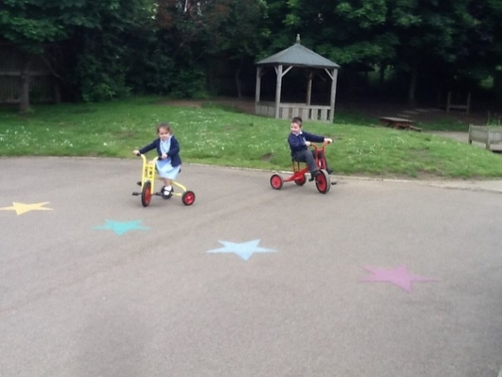
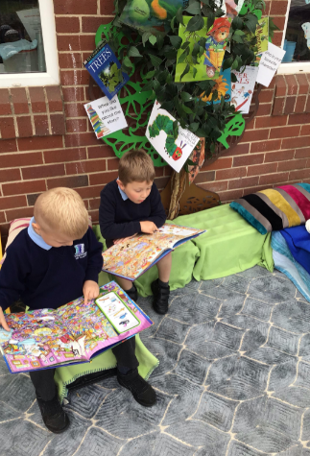
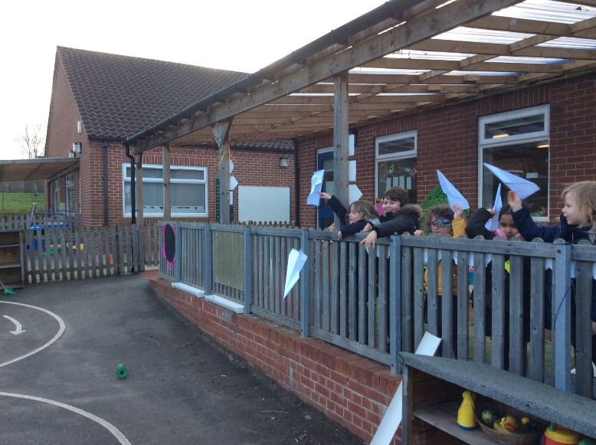
A typical day in the EYFS
Free-flow access to the outdoor area during Continuous Provision.

Slide 30
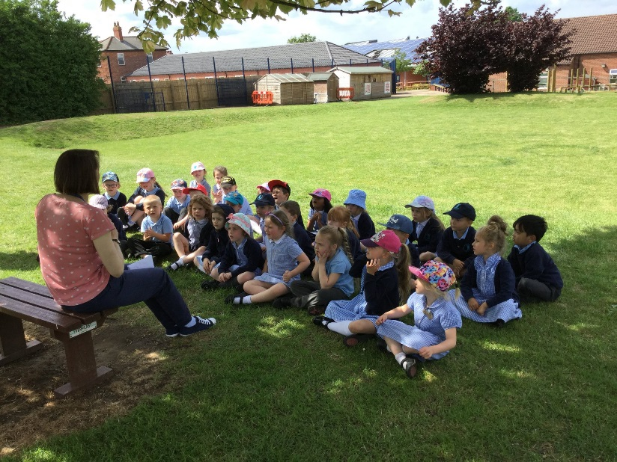
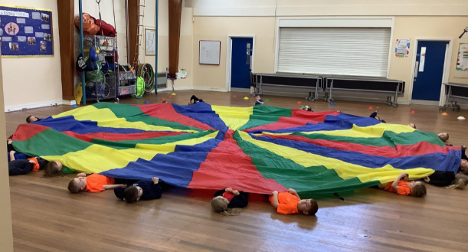
A typical day in the EYFS
Story Time
Golden Time
Home time preparation

Slide 31
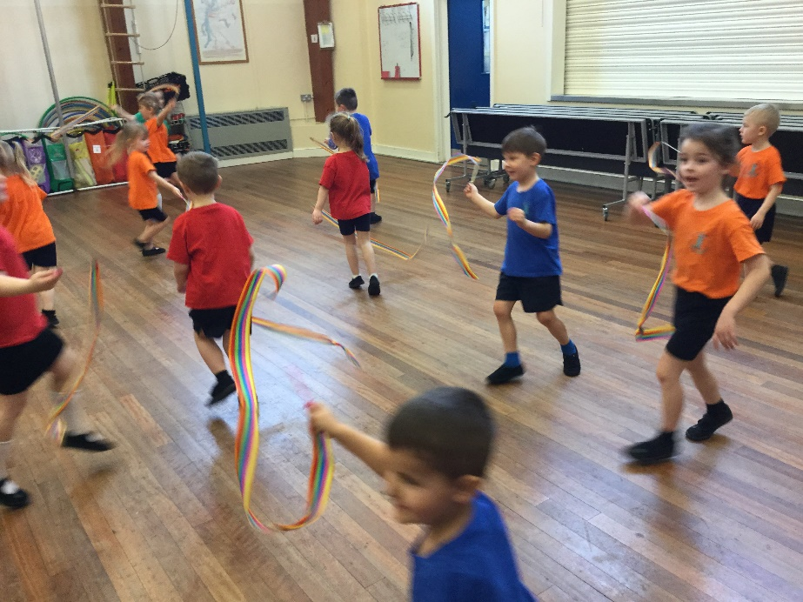
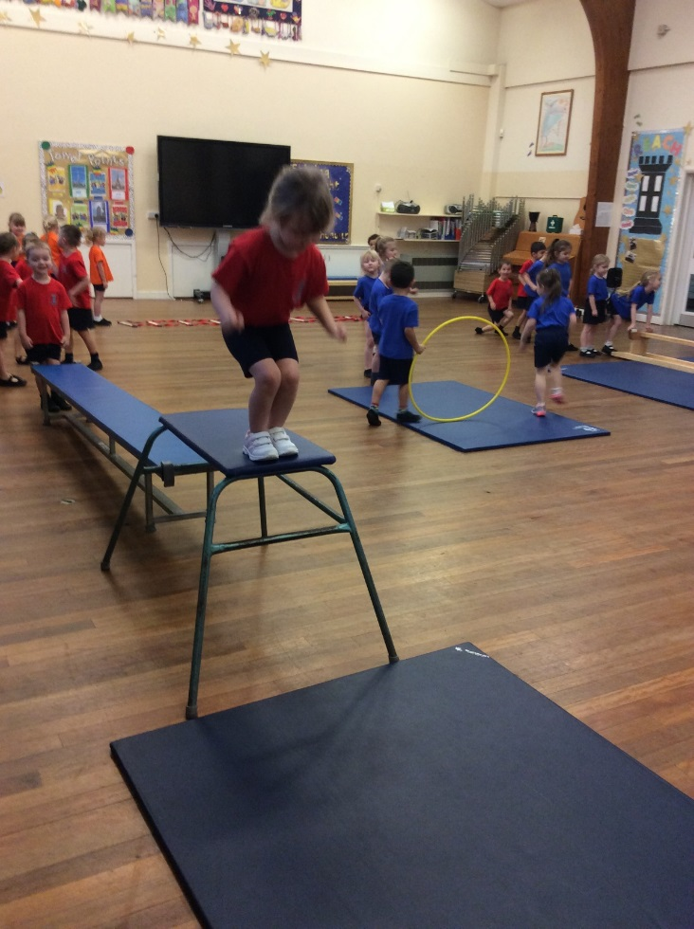
A typical day in the EYFS
P.E (Twice a week)

Slide 32
Assembly/Collective Worship
Collective Worship takes places within the Early Years setting in Terms 1 and 2.
Reception children then join the rest of the school for an additional three sessions per week in January.

Slide 33
What shall I do now?
Complete and hand back admissions form and consent forms once you receive them.
Please let us know of any important medical information/allergies.
Present your child’s birth certificate.
Make an appointment for a home visit.
Take a look at our uniform on the Uniform Direct website (best to order in July)
Keep checking emails for any further information e.g class, tower team.
SSpeak to Club House if you require before and after school childcare.

