Slide 1
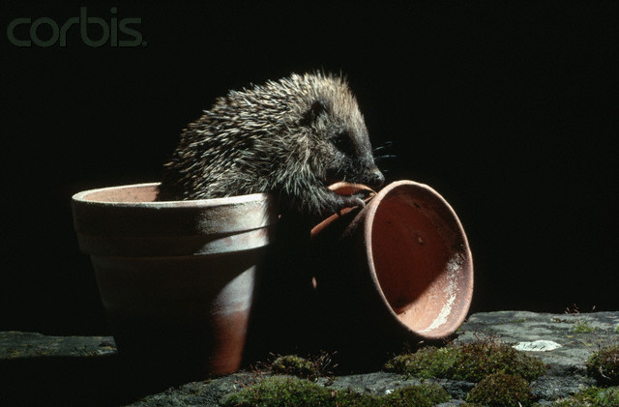
The hedgehog

Slide 2
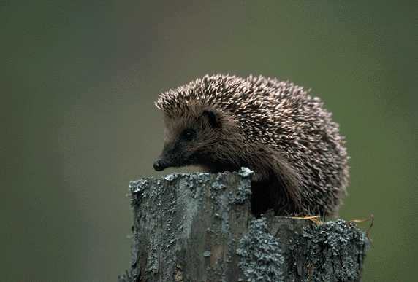
A hedgehog is a small mammal covered with a thick coat of sharp spines.

Slide 3
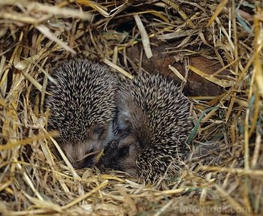
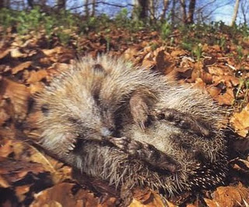
Hedgehogs sleep in small burrows or holes in a nest of grass and tangled leaves. They also sleep under shrubs, rocks or hollow logs during the day.

Slide 4
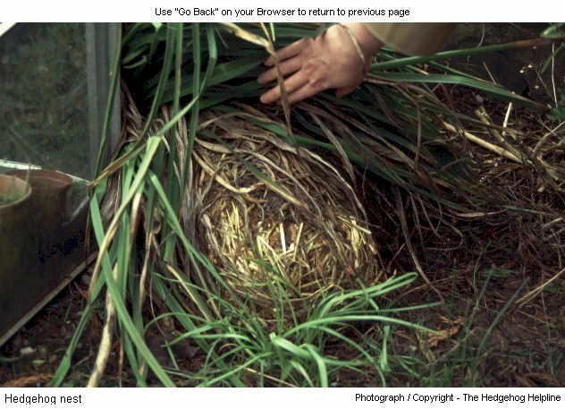
Hedgehogs hibernate in winter.During autumn they build a special nest to sleep in.

Slide 5
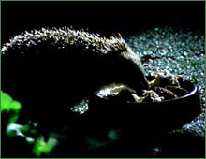
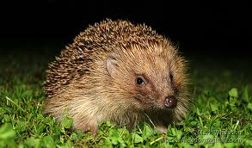
Hedgehogs are nocturnal animals. That means that they sleep and rest during the day and are most active at night.

Slide 6
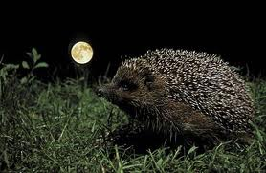
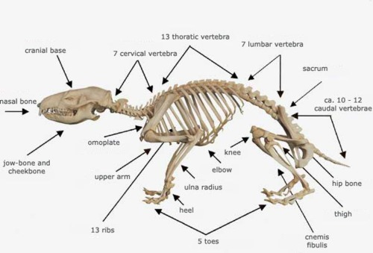
Hedgehogs have poor eyesight but can hear and smell very good. They have a pointed snout and four short legs. They even have a short little tail.

Slide 7
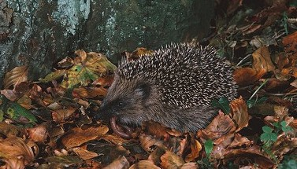
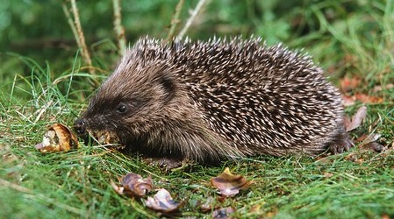
Hedgehogs eat insects, worms, slugs and snails.

Slide 8
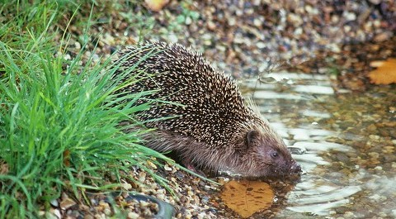
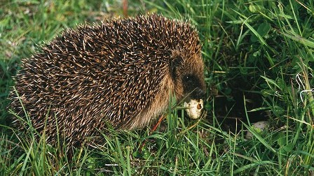
Their favourite food is eggs.

Slide 9
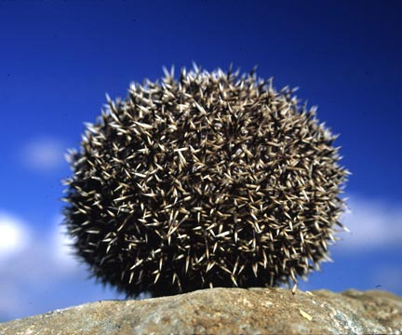
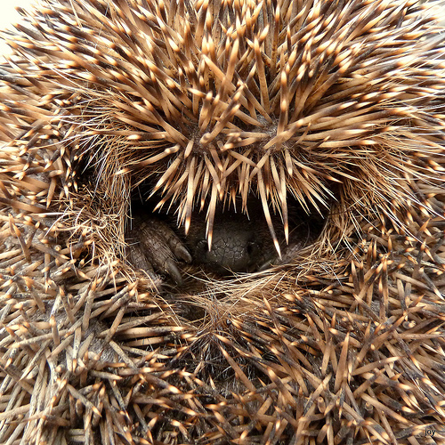
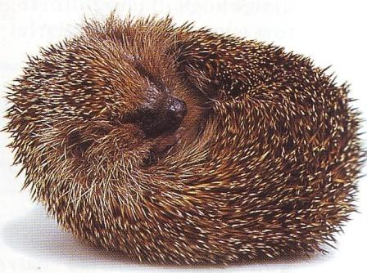
If threatened, the hedgehog freezes and rolls into a ball with its spine sticking out for defence.

Slide 10
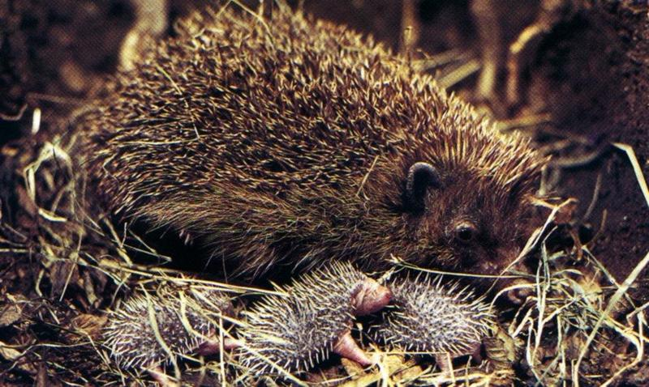
Hedgehogs have 2 to 5 babies in the spring.

Slide 11
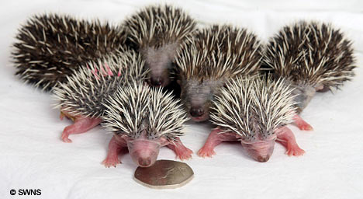
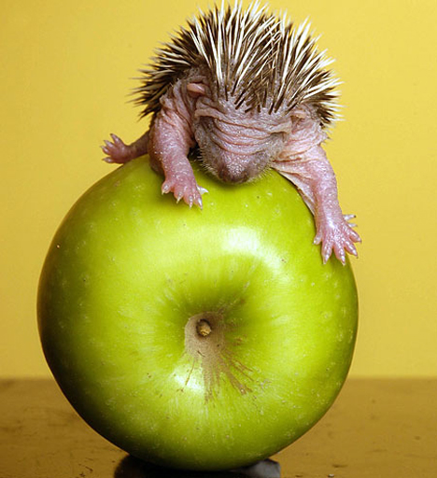
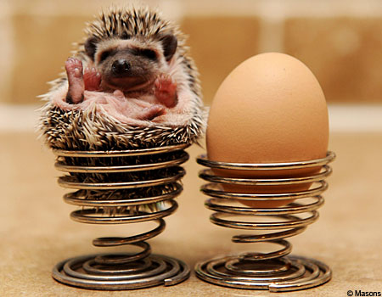

Slide 12


